Slide 1
Health analysis of India
2012-2013
By
Sowmya.L.R

Slide 2
Analysis overview
What are the vulnerable communities
Where do they exist?
Measures made by government for them

Slide 3
Annual Health Survey on EAG states : 2012 - 2013
Vulnerable communities
EAG - Empowered Action Group
Group of socio-economic backward states
EAG states have high fertility rate and high infant mortality rates
26 key indicators have been studied on EAG states
Source of dataset Annual Health Analysis of India

Slide 4
Existence of vulnerable communities - EAG states
Uttarakhand
Rajasthan
Uttar Pradesh
Bihar
Jharkhand
Odisha
Chhattisgarh
Madhya Pradesh
Assam

Slide 5
Key indicators observed during this analysis
Key indicators which identified EAG community as vulnerable
Population below 15 yrs of age
Total Fertility Rate
Crude Birth Rate
Infant Mortality Rate
Literacy rate
Childhood diseases

Slide 6
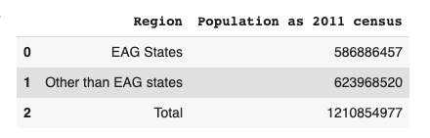
Impact of EAG population
EAG states account for 48% of total population

Slide 7
Need of analysing EAG community
A country’s health status is monitored by the following key indicators
Total Fertility Rate
Crude Birth Rate
Infant Mortality Rate
Crude Death Rate
A country is said to be healthy only if it has balanced Birth rate and reduced Death rate

Slide 8
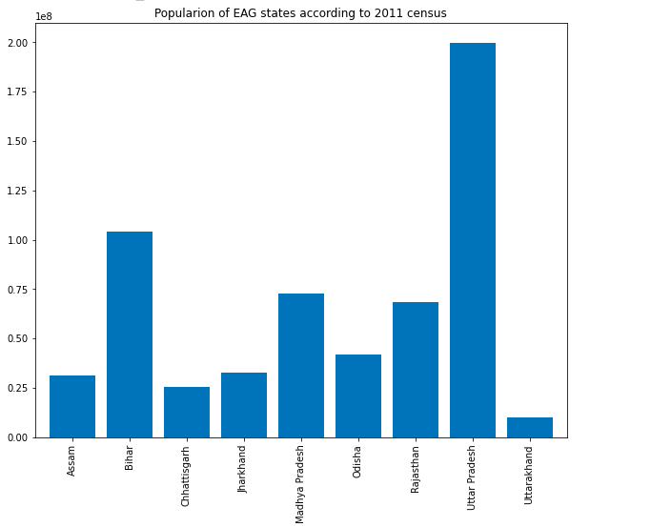
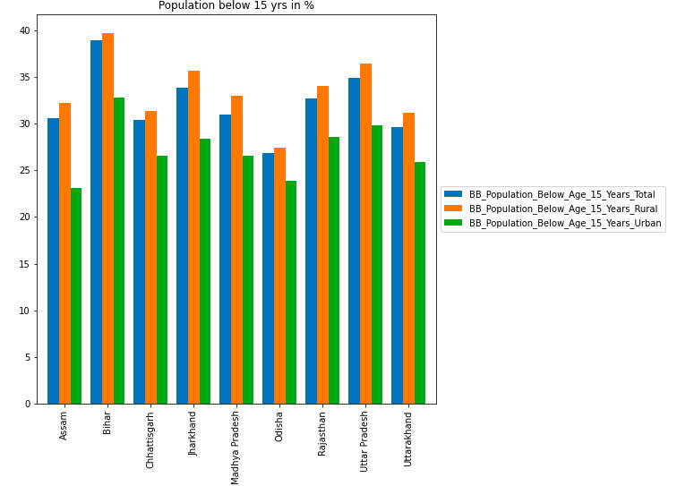
Population below age 15 in EAG

Slide 9
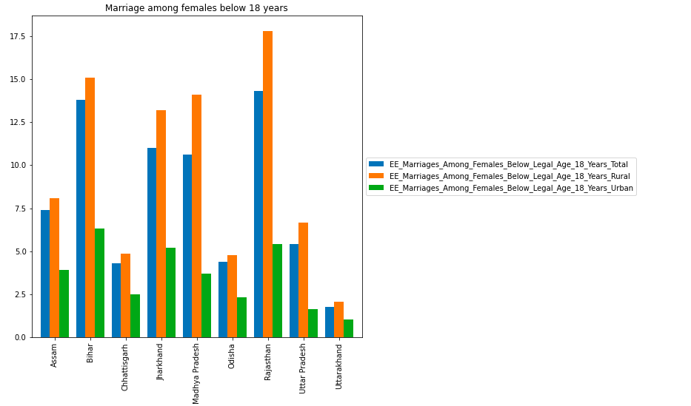
Female marriage below legal 18

Slide 10
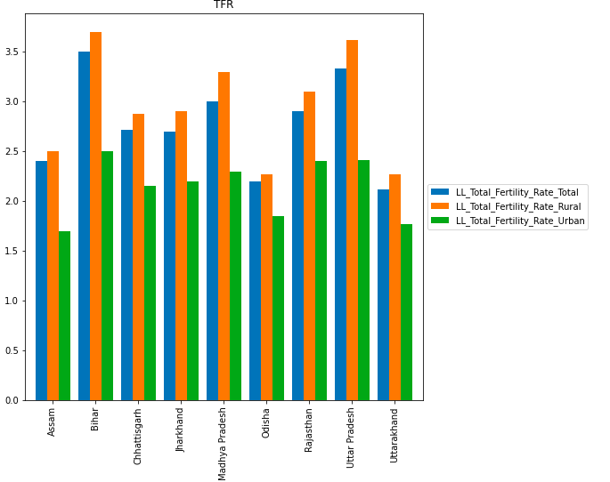
Total Fertility Rate
TFR estimate the average number of children that a woman would have over her childbearing years (i.e. age 15-49)
As per the research the avg fertility rate of India Fertiltiy rate of India is 2.6
In EAG the highest is 3.5 and it is from Bihar

Slide 11
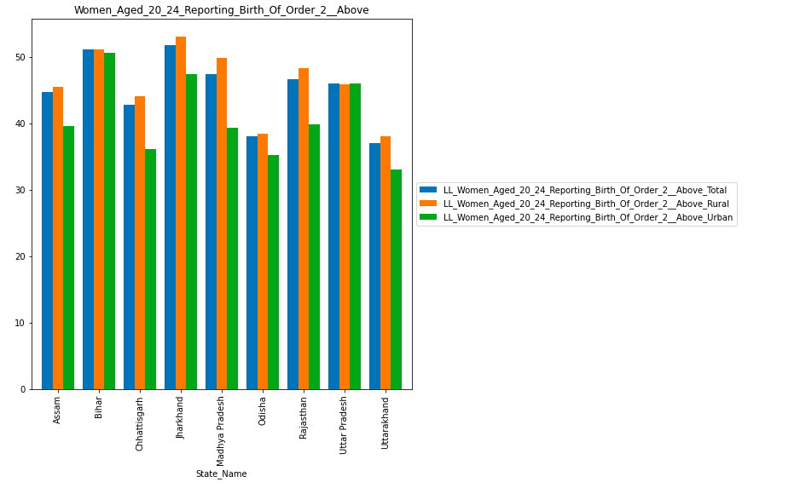
Women having children of order 2 at the age 20-24

Slide 12
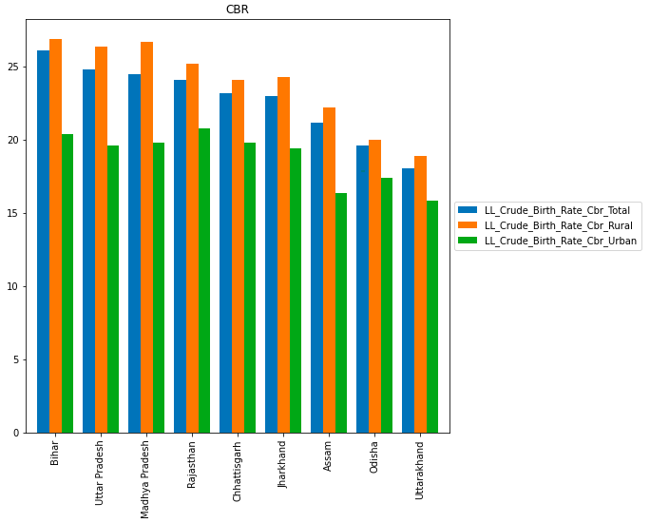
CRUDE BIRTH RATE
The crude birth rate is the number of live births occurring among the population of a given geographical area during a given year, per 1,000 mid-year total population of the given geographical area during the same year
CBR = (b ÷ p) X 1,000
As per studies CBR_INDIA_2011, CBR of India by 2011 census is 21.8
In EAG it is above 25 and it is from Bihar

Slide 13
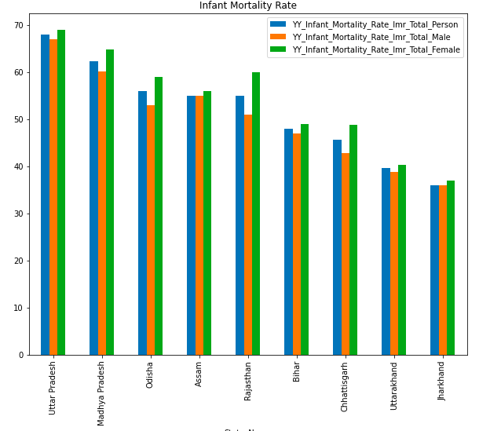
Infant Mortality Rate
The infant mortality rate is the number of deaths of children under one year of age per 1,000 live births
As per the statistics, IMR of INDIA 2011 IMR of India by 2011 census is 43
In EAG it is above 65 and it is from Uttar Pradesh

Slide 14
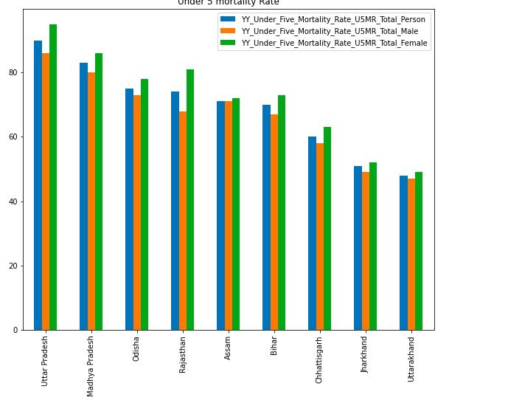
Under 5 Mortality Rate
As per statistics, U5MR INDIA 2011 it is 61
But in EAG it is above 80 and it is from Uttar Pradesh

Slide 15
Reasons for high mortality rate
Low effective literacy rate
Many childhood diseases
Diarrhoea
Respiratory infection
Fever
Women marrying at younger age

Slide 16
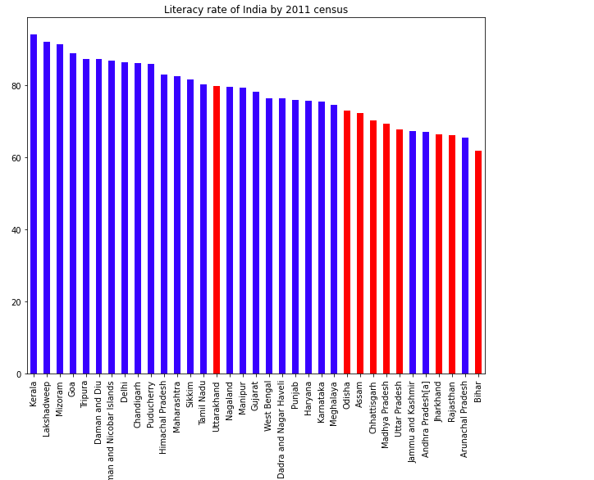
Literacy Rate in EAG as per 2011 census

Slide 17
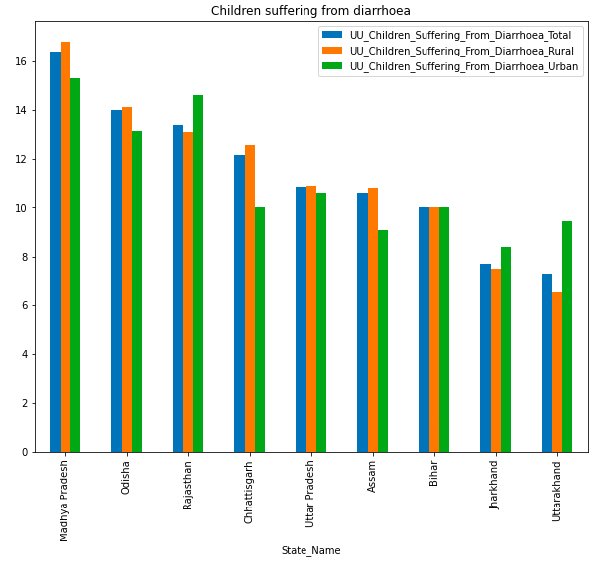
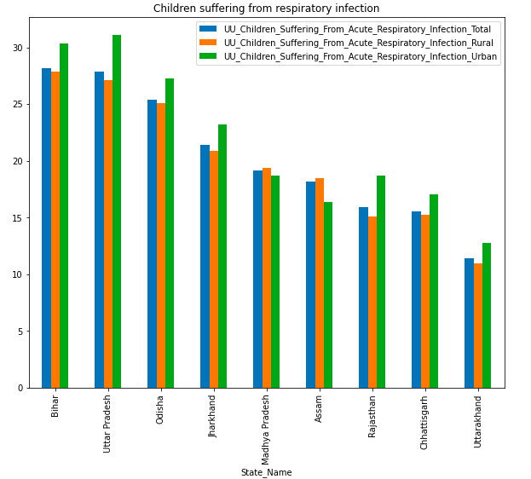
Childhood disease

Slide 18
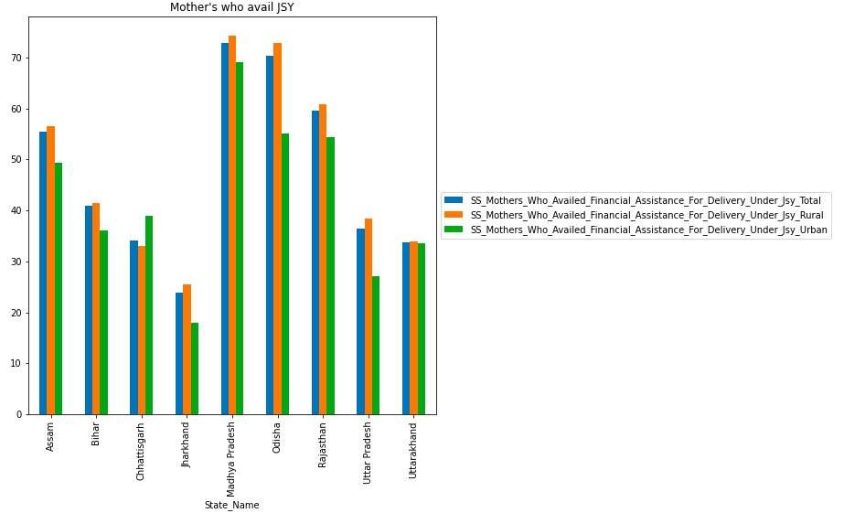
Janani Suraksha Yojana
This scheme was introduced by the Indian government to improve the health status especially in EAG community
This scheme was introduced by the Indian government in 2005 with the aim of reducing maternal and infant mortality by promoting institutional deliveries
It provides
Prenatal care
Delivery care
Post natal care

Slide 19
Impact of JSY in EAG states

Slide 20
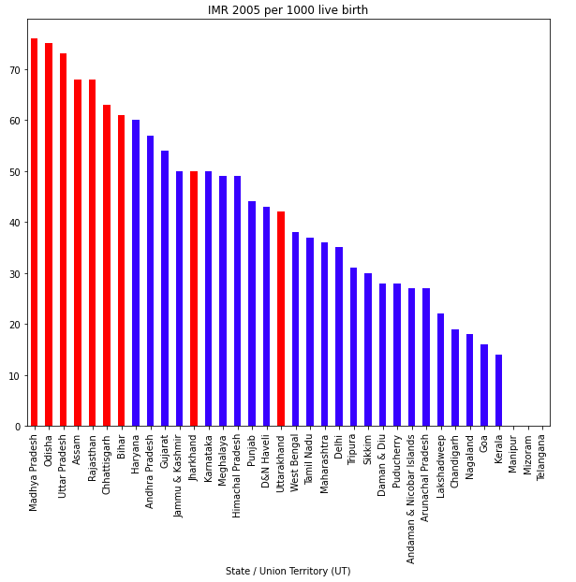
Infant Mortality Rate of India 2005
IMR in EAG is above 70

Slide 21
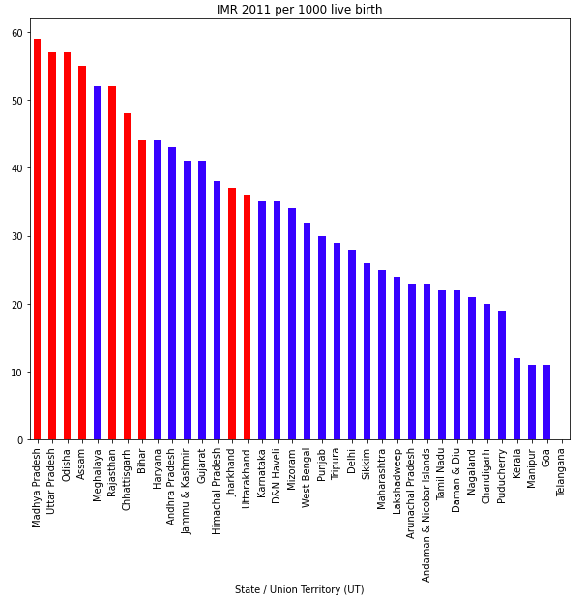
Infant Mortality Rate of India 2011
IMR in EAG is above 58

Slide 22
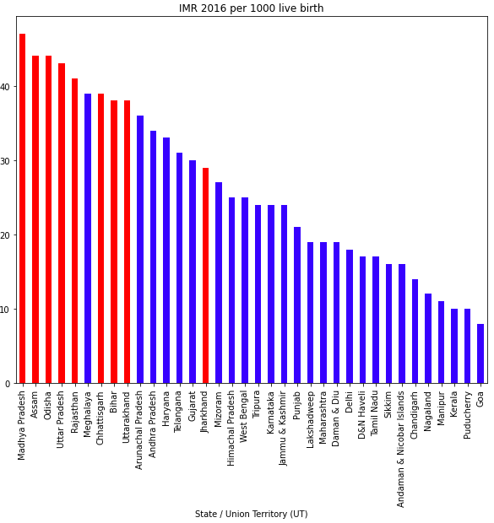
Infant Mortality Rate of India 2016
IMR in EAG is less than 50

Slide 23
Thank you

